Slide 1

Visual Programming
Vishal Dwivedi
Institute for Software Research Carnegie Mellon University
05-899D: Human Aspects of Software Development (HASD)
Spring 2011 – Lecture 19

Slide 2
Agenda
Definitions
Motivation for using Visual Programming Languages (VPLs)
Popular VPLs
Understanding VPL Research via Taxonomies
Important Categories
Language Classifications
Language Features
Purpose
Design Issues
Studies
Empirical evidence for VPLs
Empirical evidence against the use of VPLs
Conclusions

Slide 3
Definitions Programming
“Programming”
‘‘The process of transforming a mental plan of desired actions for a computer into a representation that can be understood by the computer’’ – Jean-Michel Hoc and Anh Nguyen-Xuan
“Single-dimensional characteristics”
The compilers or interpreters programs as long, one-dimensional streams.

Slide 4
Definitions Visual Programming
“Visual Programming”
“Programming in which more than one dimension is used to convey semantics.” - Myers, 1990
“Token”
“A collection of one or more multi-dimensional objects”.
Examples:
Multi-dimensional graphical objects
Spatial relationships
Use of the time dimension to specify “before-after” semantic relationships.
“Visual Expression”
“A collection of one or more tokens”
Notes:
Examples of such additional dimensions are the use of multi-dimensional objects, spatial relationships, or the use of the time dimension to specify “before-after” semantic relationships.
Brad A. Myers. "Taxonomies of Visual Programming and Program Visualization," Journal of Visual Languages and Computing. vol. 1, no. 1. March, 1990. pp. 97-123.
Margaret M. Burnett, “Visual Programming” In the Encyclopedia of Electrical and Electronics Engineering (John G. Webster, ed.), 1999

Slide 5
Definitions Visual Programming Language
“Visual Programming Language”
“Any system where the user writes a program using two or more dimensions” [Myers, 1990]
“A visual language manipulates visual information or supports visual interaction, or allows programming with visual expressions” [Golin , 1990]
“A programming language that lets users create programs by manipulating program elements graphically rather than by specifying them textually”.
“A set of spatial arrangements of text-graphic symbols with a semantic interpretation that is used in carrying out communication actions in the world”. [Lakin, 1989]
Notes:
Fred Lakin, John Wambaugh, Larry J. Leifer, Dave Cannon, Cecilia Sivard: The electronic design notebook: performing medium and processing medium. The Visual Computer 5(4): 214-226 (1989)
Eric J. Golin, Robert V. Rubin, James Walker II: The Visual Programmers Workbench. IFIP Congress 1989: 143-148

Slide 6
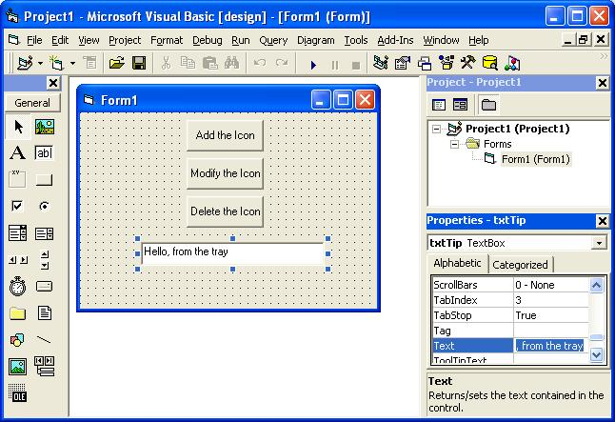
What is not a Visual Programming Language? Visual programming environments (VPE)
Programming Languages like Visual Basic, Visual C++, Visual C sharp, Delphi, etc do not satisfy the multi-dimensional characterization.
They are primarily Textual languages with:
A graphical GUI builder
A visual user interface

Slide 7
Motivation Psychological perspective
Language determines thought and that linguistic categories limit and determine cognitive categories [Sapir–Whorf hypothesis in linguistics]
In longer sentences meaning of each word may be clear, but the way in which they are strung together makes little sense imposes a tremendous mental workload to understand. [Wickens]
Most design tasks require 3 cognitive skills: search, recognition and inference.
Diverse set of views (and studies) exist today about whether VPLs aid in search or cognition.
Notes:
Sapir, E. (1929): 'The Status of Linguistics as a Science'. In E. Sapir (1958): Culture, Language and Personality (ed. D. G. Mandelbaum). Berkeley, CA: University of California Press
Christopher D. Wickens, “Engineering Psychology and Human Performance”, 3rd Edition
J. H. Larkin and H. A. Simon. Why a diagram is (sometimes) worth ten thousand words. Cognitive Science, 11:65-99, 1987.

Slide 8
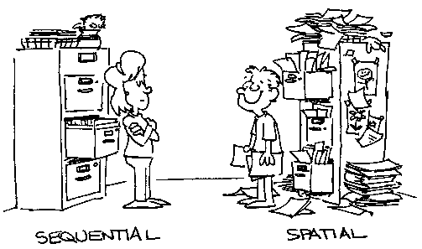
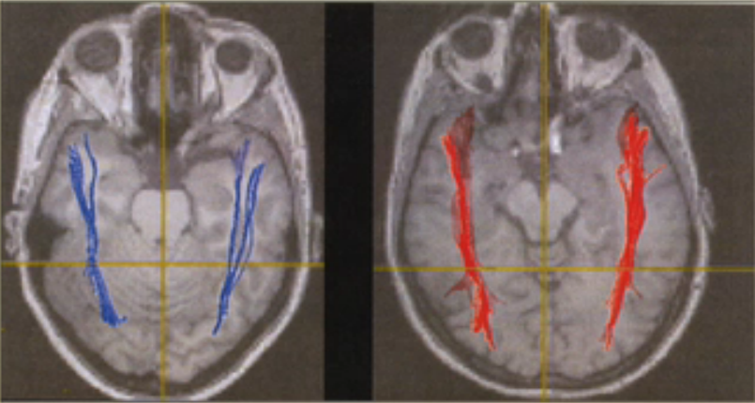
Motivation Neuroscience perspective: Many people think in pictures*
Temple Grandin: The world needs all kinds of minds, TED Talk
Less than 30% of the population strongly uses visual/spatial thinking, another 45% uses both visual/spatial thinking and thinking in the form of words, and 25% thinks exclusively in words.
[Linda Kreger Silverman]
However, this is a controversial theory, with deeply diverse views and studies.
Notes:
Temple Grandin: The world needs all kinds of minds
http://www.ted.com/talks/temple_grandin_the_world_needs_all_kinds_of_minds.html
http://www.gifteddevelopment.com/ADJ/adj.htm

Slide 9
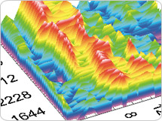
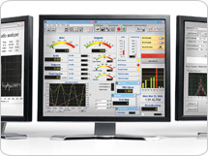
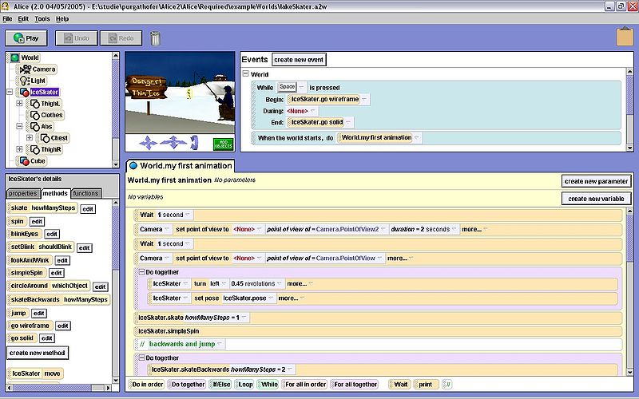
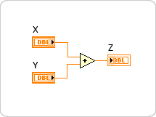
Motivation Some applications are very well suited to graphical development approaches
Scientific visualization
Simulations
User Interfaces
Signal Processing
Data Displays
…

Slide 10
(Claimed) Advantages of VPLs
Fewer programming concepts
Concreteness
Explicit depiction of relationships
Immediate visual feedback
Parallel computation is a natural consequence of many visual programming paradigms

Slide 11
(Claimed) Disadvantages of VPLs
“Deutsch Limit” *
The problem with visual programming is that you can't have more than 50 visual primitives on the screen at the same time.
Some situations in which text has superiority:
Documentation,
Naming to distinguish between elements that are of the same kind, and
Expressing well-known and compact concepts that are inherently textual, e.g. algebraic formulas.
[Fred Lakin]
Notes:
From Wikipedia Article:
The term was made up by Fred Lakin, after Peter Deutsch made the following comment at a talk on visual programming by Scott Kim and Warren Robinett: "Well, this is all fine and well, but the problem with visual programming languages is that you can’t have more than 50 visual primitives on the screen at the same time. How are you going to write an operating system?"

Slide 12
VPL Research timeline
Action Graphics
FORMAL
ThingLab
Hi-Visual
LabView
PROGRAPH
PIGS
Pict
Rehearsal
SmallStar
Forms
Editing by Example
PICT
Lotus 1-2-3
SIL-ICON
VisiCalc
HiGraphs
Miro
StateMaster
AMBIT/G/L
Grail
GAL
Graphical Program Editor
Query by Example
Pygmalion
I/O Pairs
Cube
Cantata
SchemePaint
CODE 2.0
Iconicode
MViews
AVS
Mondrian
ChemTrains
Vampire
VIPR
SPE
LOFI/HIPI
FOXQ
VMQL
GXL
Euler View
Yahoo Pipes
Popfly
1960
1980
1990
2000
Techniques
Graphs
Flowcharts
Flowchart derivatives
FORMS
Demonstrational
Techniques
Graphs
Flowcharts
Flowchart derivatives
FORMS
Demonstrational
Data Flows
Spreadsheets
Matrices
Jigsaw Puzzles
Petri nets
Flowchart derivatives
Techniques/Goals
3D Rendering
Visual Hierarchy
Procedures
Control Structures
Programmable Graphics
Animations
Video Imagery Exploitation
General purpose, declarative language
Audio, video and image processing
Graphical models from behavioral models
Learning and Cognitive abilities in vision processes
Handling Scalability, typing, and imperative design
Collaborative Software Development
Techniques/Goals
Child Learning
Xquery by FORMS
Spreadsheet Analysis
Visual Model Query
Layouts
Specification and Interchange
Mashups
Web-based design
Programming for end-users (2003) / non-Professionals

Slide 13
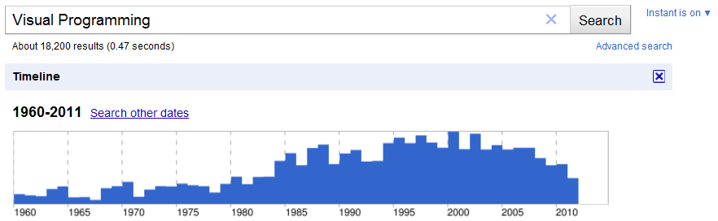
VPL Research timeline
Period of
Reality Check
Period of
Inflated Expectations
Period of Early
promises
Technology
Trigger
1960
1980
1990
2000
[Ellis, 1969] : GRAIL
[Smith, 1975] : Pygmalion
[Myers, 1990] : Taxonomies for VPL
[Repenning, 1992] : Agent Sheet
[Burnett, 1994] : Broad Classifications for VPL Research
[Kirsten N. Whitley, 1997]: User Studies (for/against VPLs)
[MacLaurin, 2009] : KODU

Slide 14
(Claimed) Goals of VPL research
To strive for improvements in programming language design.
To make programming more accessible to some particular audience.
To improve correctness with which people perform programming tasks.
To improve the speed with which people perform programming tasks.

Slide 15
(Apparent) Goals for VPL research over last 40 years
Let users program in Visual Languages
(Almost) Make textual languages redundant
Make programming more accessible
Support domain -specific designs
Support the cognition aspect of Programming
Strive for improvements in programming language design
1960
1980
1990
2000

Slide 16
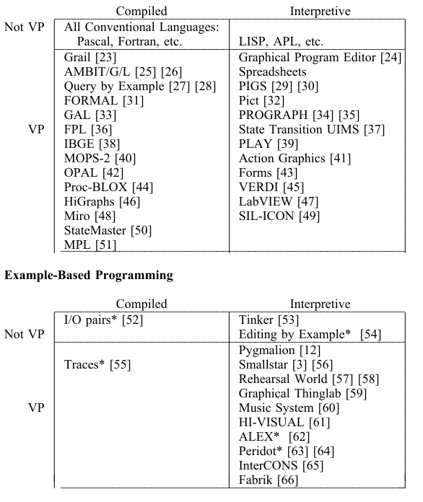
Taxonomies of Visual Languages (1)
[Myers, 1990]
Classification (8 blocks)
Visual Programming or not,
Example-Based Programming or not,
Interpretive or Compiled.

Slide 17
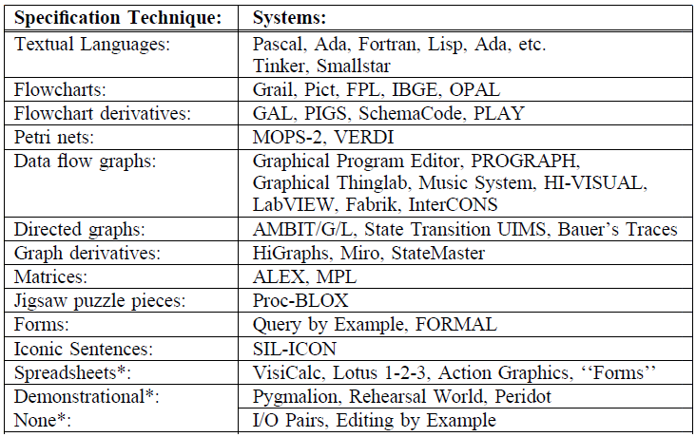
Taxonomies of Visual Languages (2) Classification by specification technique
[Myers, 1990]

Slide 18
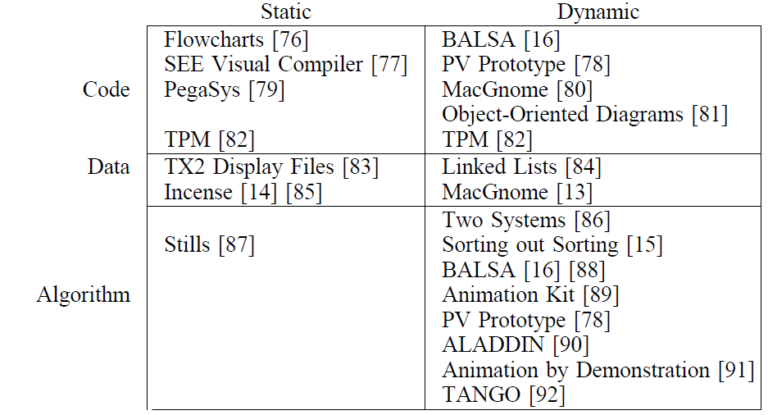
Taxonomies of Visual Languages (3) Classification of program visualization systems
[Myers, 1990]

Slide 19
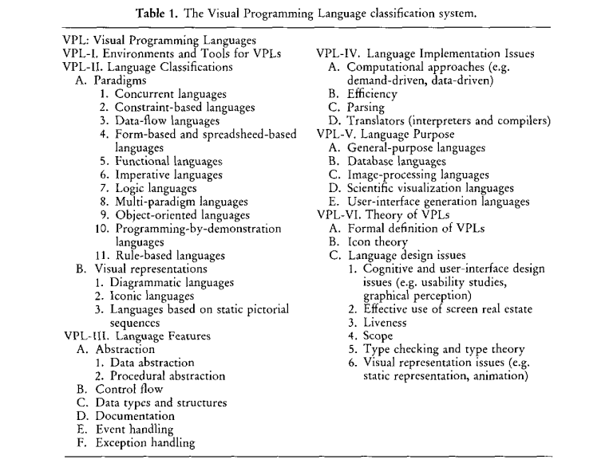
VPL research – key categories [Burnett, 1994]

Slide 20
VPL research – Classification based on Paradigms
Concurrent languages
Constraint-based languages
Data-flow languages
Form-based and spreadsheet-based languages
Functional languages
Imperative languages
Logic languages
Multi-paradigm languages
Object Oriented languages
Programming-by-demonstration languages
Rule-based languages

Slide 21
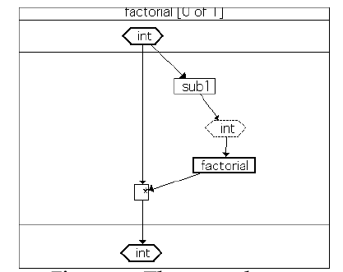
Functional Visual Programming Clarity (Others: Object Flow, GVL, DEAL, …)
Clarity is a functional language in the style of ML
Motivated by the functional database model
Supports incremental, interactive design of programs
Claims: Visualization introduces an additional conceptual level.
Notes:
Tom Addis, Jan Addis, Drawing Programs: The Theory and Practice of Schematic Functional Programming
CLARITY (http://www.clarity-support.com/)

Slide 22
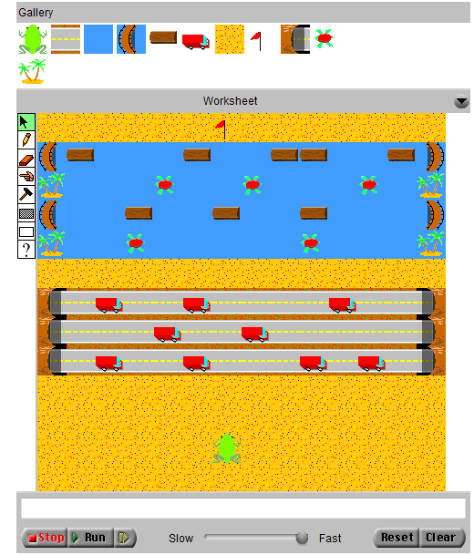
Rule Based Visual Programming Agent Sheet [Others: MOSL, VISPATCH, SAM, VXT, …]
Programming Paradigm for Programming with Pictures, particularly visual Simulations and rules.
Rule based design to:
animate agents
play sounds and MIDI instruments
speak text
react to mouse and keyboard events
visualize values as colors and plots
query web pages, control web browsers
Notes:
Agent Sheet: http://www.agentsheets.com

Slide 23
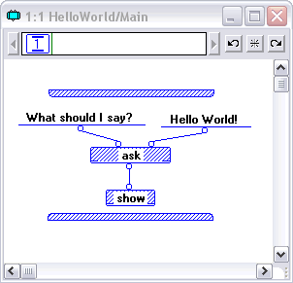
Data Flow based Visual Programming PROGRAPH [Others: ObjectFlow, The Cube Language, SWIFT, Taverna, …]
Method case
General-purpose Data-flow driven VPL
Information flows through components
Data is transformed at certain points in the program
Operations
Notes:
Simulating Graphs as Physical Systems, A. Frick, G. Sander and K. Wang in
Dr. Dobbs Journal, August 1999
R. Davidson and D. Harel. Drawing Graphs Nicely Using Simulated Annealing.
ACM Transactions on Graphics, 15(4):301-331, October 1996.
Fruchtermann, T. M. J. and Reingold, E. M. (1991). Graph drawing by force
-directed placement. Software Practice and Experience, 21(11):1129--1164.

Slide 24
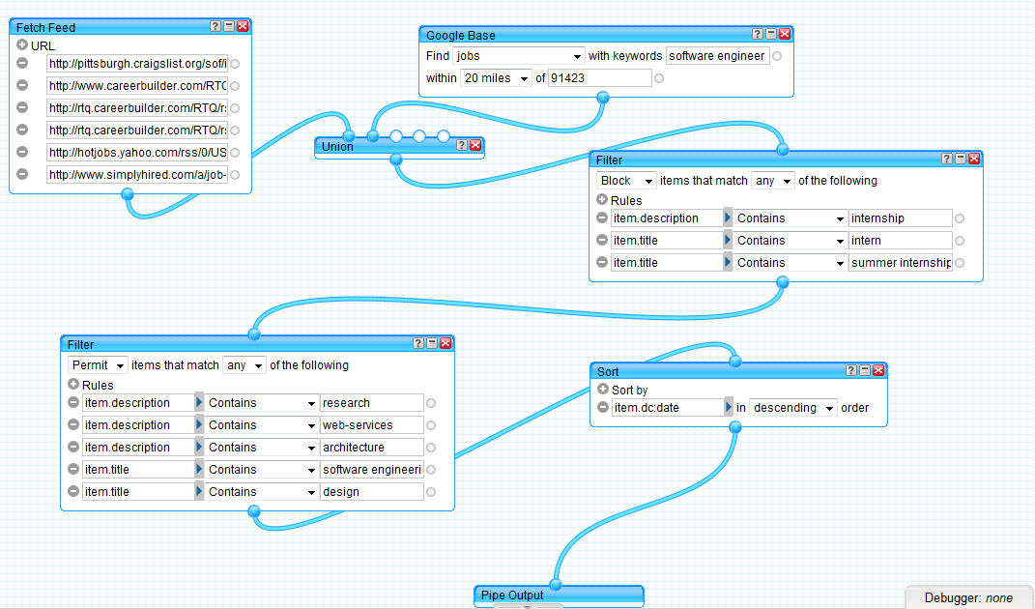
Data Flow based Visual Programming Yahoo Pipes (http://pipes.yahoo.com)
Data-feed aggregation

Slide 25
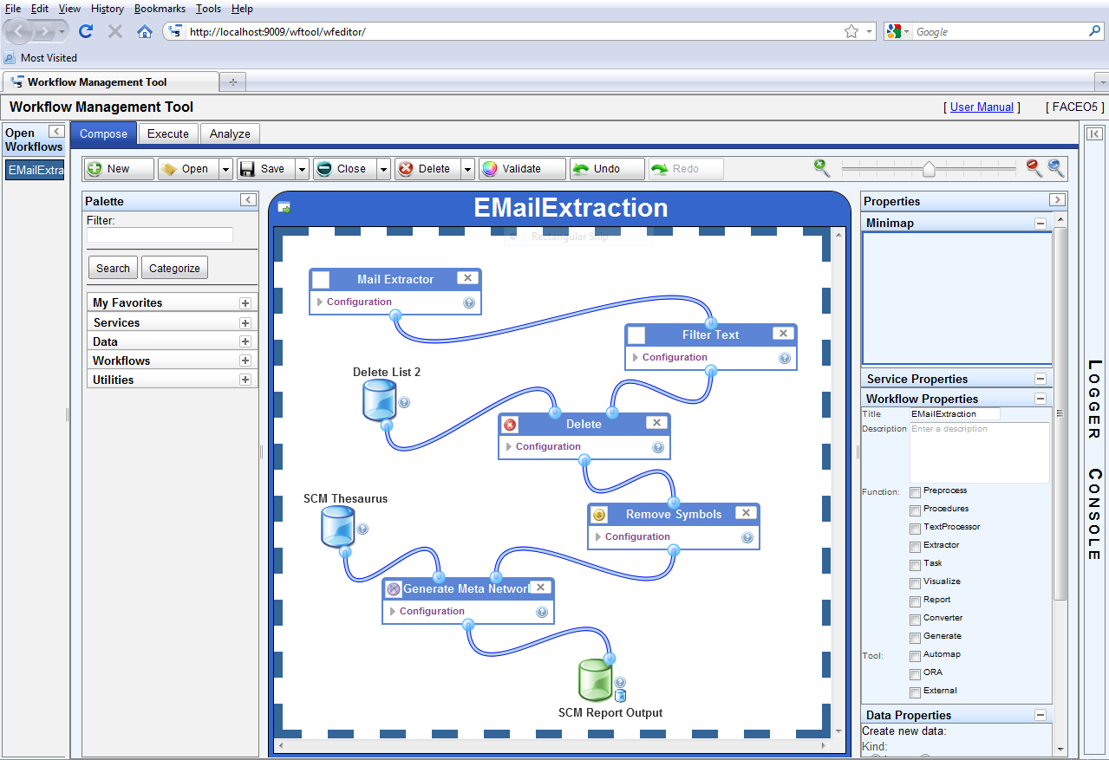
Another Data Flow based VPL SWiFT– a web-based workflow tool for high-level web service composition
Supports heterogeneous, interactive, web-service composition and provides feedback for quality attributes such as performance, security/privacy (in progress)

Slide 26
VPL research – Classification based on Visual Representations
Diagrammatic languages
Iconic languages
Languages based on static pictorial sequences
Sound- or speech-based languages

Slide 27
Iconic Languages Toon Talk http://www.toontalk.com
c
a

Slide 28
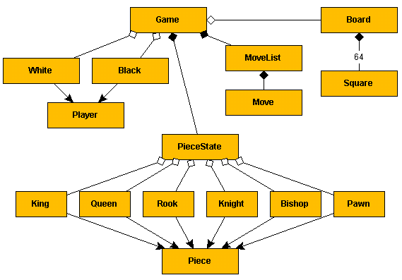
Diagrammatic Languages
c
b
a

Slide 29
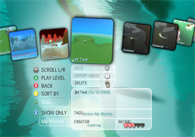


Using 3D Icons Microsoft Kodu -- a software designed to program games with a 3D Interface (http://en.wikipedia.org/wiki/Kodu)
It avoids typing code by having users construct programs using visual elements via a game controller
Rather than a bitmapped or 2D display, programs are executed in a 3D simulation environment, similar to Alice

Slide 30
VPL research – Language Features
Abstraction
Data abstraction
Procedural abstraction
Control flow
Data types and structures
Documentation
Event handling
Exception handling

Slide 31
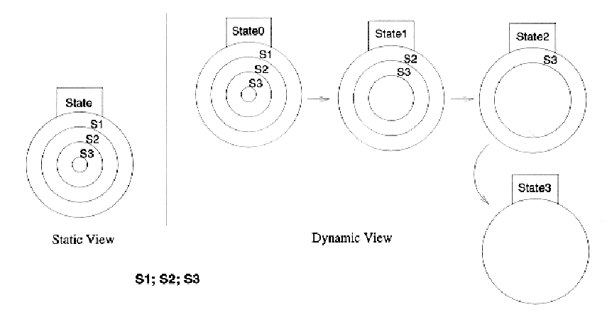
VIPR (Visual Imperative Programming)
Notes:
http://www.cs.colorado.edu/department/publications/reports/docs/CU-CS-768-95.pdf

Slide 32
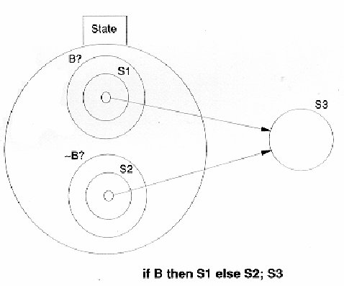
VIPR
Object-oriented
Inheritance, polymorphism, etc.
Semantics are similar to C++

Slide 33
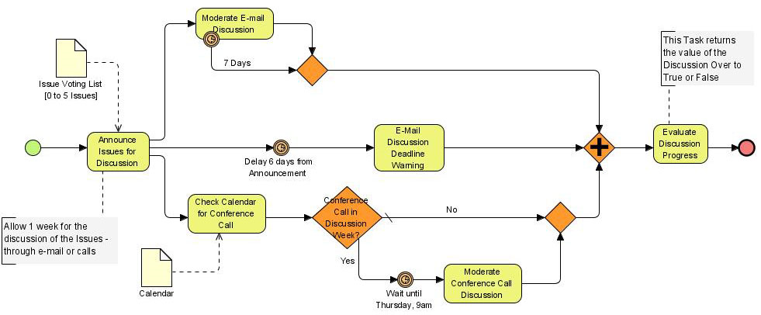
BPMN: Business Process Modeling Notation Control Flow – Used mainly for documentation
www.bpmn.org

Slide 34
VPL research – Language Purpose
General-purpose languages
Database languages
Image-processing languages
Scientific visualization languages
User-interface generation languages
Languages for programming web-based applications
Languages for education

Slide 35
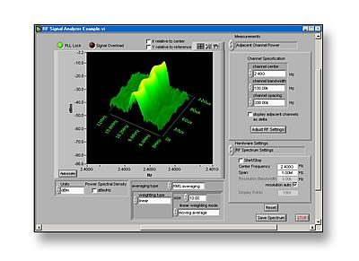
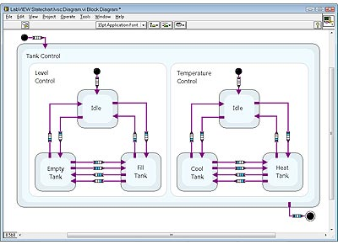
Scientific visualization languages LabView -- a graphical language designed for engineers and scientists (http://www.ni.com/labview)
LabView is used for:
Data flow programming
Graphical programming
Formal testing

Slide 36
Empirical Studies FOR/AGAINST use of VPLS

Slide 37
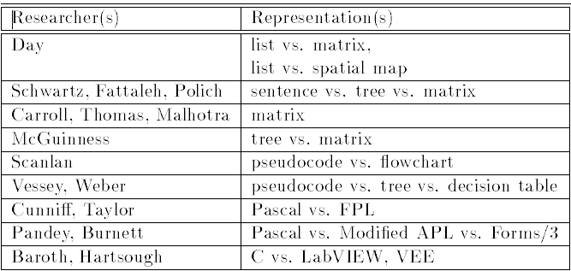
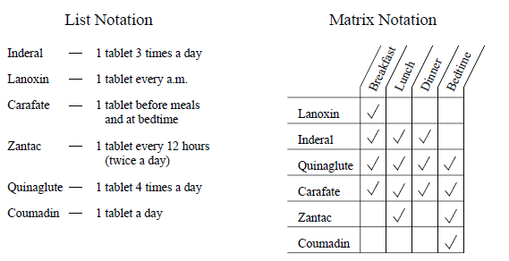
Evidences For (Non-Programming Study) People perform better with organized and explicit information

Slide 38
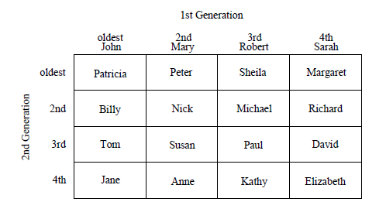
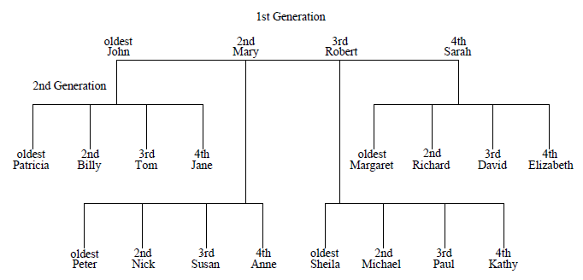
Evidences For (Non-Programming Study) Notations are not superior in an absolute sense* [McGuinness]
Used Tree notation and matrix notation to encode information about family relationships.
Asked questions about which siblings can go out, or inherit family property based on some constraints.
Subjects who learned the tree notation took more than twice as long as subjects who learned the matrix.
Proved Match-mismatch hypothesis: Notations are probably not superior in an absolute sense; rather, they are good in relation to specific tasks. (Primarily used for search)
Reason: Mental steps to access the elements

Slide 39
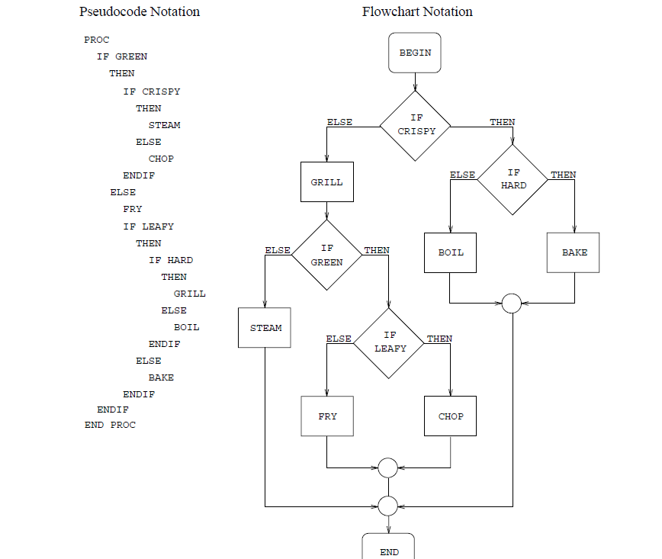
Evidences For (Programming Study) Flowcharts as a notation for control flow [Scanlan]
Experiment:
Detect differences in the comprehension of conditional logic expressed in structured pseudo code vs structured flowcharts
3 algorithms (simple, medium and difficult complexity)
Independent variables:
Representation and algorithm complexity.
5 dependent variables:
time taken to comprehend an algorithm
time spent answering questions about an algorithm
the number of times a subject brought an algorithm into view
Correctness of answers
the subjects' confidence

Slide 40
Evidence ‘For’ VPLs: Summary
[T. R. G. Green, 1992]
Researcher | Representations Used | Results
Day | List vs Matrix List vs Spatial Map | Correctness using Matrix Format: 78% Correctness using List Format: 56%
Schwartz, Fattaleh, Polich | Sentence vs. Tree vs. Matrix | Matrix outperformed sentence rewrites and Tree diagrams Superiority of the matrix grew as the problem size grew.
Carroll, Thomas, Malhotra | Matrix | Using a matrix helped users to improve their performance while solving temporal iso-morph problem (scheduling problem)
Scanlan | Pseudo code vs. Flowchart | Flowcharts performed much better while representing conditional logic as compared to pseudo-code

Slide 41
Evidences Against (Non-Programming Study) Notations are not superior in an absolute sense [Wright and Reid]
Experiment:
Evaluate relative strength of prose, short sentences, decision trees and matrices in problem-solving situations
Using a series of rules dictating the appropriateness of different space vehicles for space travel.
Each subject asked a series of 36 problems deciding to choose a mode of travel
Independent variables:
Representation (between-subjects), memorization (within-subjects) and question difficulty (within-subjects).
Three Stages:
Stage1: the subjects had the rules available to consult.
Stage2: the rules were removed without warning.
Stage3: subjects were told to memorize the rules
Results:
Prose format more error prone
Stage 1:
No significant differences in the error rates
Table yielded significantly faster times
Stage 2
No significant differences in the error rates
Mean percent error for the tree and table deteriorated over trials
Performance with the prose and short sentences improved.

Slide 42
Evidences Against (Programming Study) Flowcharts as a notation for control flow [Shneiderman et al]
Experiment:
5 experiments testing the effects of flowchart documentation on novice programmers in comprehension, composition, debugging and modification tasks
Result
None of the five yielded significant differences between the flowchart and non-flowchart groups
Design Flaws
time was not a dependent variable

Slide 43
Evidences Against (Programming Study) Algorithm animation as a pedagogical aid [Stasko, Badre and Lewis]
Experiment:
XTango animation of a heap algorithm
Between-subjects design to measure learning via a textual description versus learning via text accompanied by an animation.
Independent variable:
Presence of the animation
Dependent variable:
Correctness scores
Result
No significant difference occurred in the comprehension test scores

Slide 44
Conclusions
Extensive work has been done in the field of VPL Research
However, the goals of VPLs have changed over time from being able to support programming in general to make programming easier
Recent implementations of software like KODU, Yahoo Pipes etc point to the interest in general
However, a large number of VPLs have failed
They have not been a commercial success
Perhaps, now they are evolving towards a common goal of making programming more accessible and fun, rather than supporting all aspects of programming.

Slide 45
References
Brad A. Myers. "Taxonomies of Visual Programming and Program Visualization," Journal of Visual Languages and Computing. vol. 1, no. 1. March, 1990. pp. 97-123.
Margaret M. Burnett, “Visual Programming” In the Encyclopedia of Electrical and Electronics Engineering (John G. Webster, ed.), 1999
Fred Lakin, John Wambaugh, Larry J. Leifer, Dave Cannon, Cecilia Sivard: The electronic design notebook: performing medium and processing medium. The Visual Computer 5(4): 214-226 (1989)
Eric J. Golin, Robert V. Rubin, James Walker II: The Visual Programmers Workbench. IFIP Congress 1989: 143-148
Myers, B.A., Smith, D.C., and Horn, B. “Report of the `End-User Programming' Working Group,” in Languages for Developing User Interfaces. 1992. Boston, MA: Jones and Bartlett. pp. 343-366.
Sapir, E. (1929): 'The Status of Linguistics as a Science'. In E. Sapir (1958): Culture, Language and Personality (ed. D. G. Mandelbaum). Berkeley, CA: University of California Press
Christopher D. Wickens, “Engineering Psychology and Human Performance”, 3rd Edition
J. H. Larkin and H. A. Simon. Why a diagram is (sometimes) worth ten thousand words. Cognitive Science, 11:65-99, 1987.
Temple Grandin: The world needs all kinds of minds http://www.ted.com/talks/temple_grandin_the_world_needs_all_kinds_of_minds.html
Kirsten N. Whitley. (1997). Visual Programming Languages and the Empirical Evidence For and Against. J. Vis. Lang. Comput. 8(1): 109-142.

Slide 46
References
T. R. G. Green, M. Petre. When Visual Programs are Harder to Read than Textual Programs. In Human-Computer Interaction: Tasks and Organisation, Proceedings ECCE-6 (6th European Conference Cognitive Ergonomics) (1992).
Thomas R. G. Green, Marian Petre: Usability Analysis of Visual Programming Environments: A 'Cognitive Dimensions' Framework. J. Vis. Lang. Comput. 7(2): 131-174 (1996)
Jonathan Edwards. 2007. No ifs, ands, or buts: uncovering the simplicity of conditionals. In Proceedings of the 22nd annual ACM SIGPLAN conference on Object-oriented programming systems and applications (OOPSLA '07). ACM, New York, NY, USA, 639-658.
Avraham Leff and James T. Rayfield. 2007. Webrb: evaluating a visual domain-specific language for building relational web-applications. In Proceedings of the 22nd annual ACM SIGPLAN conference on Object-oriented programming systems and applications (OOPSLA '07). ACM, New York, NY, USA, 281-300.
Seung Chan Slim Lim and Peter Lucas. 2006. JDA: a step towards large-scale reuse on the web. In Companion to the 21st ACM SIGPLAN symposium on Object-oriented programming systems, languages, and applications (OOPSLA '06). ACM, New York, NY, USA, 586-601.
Daniel D Hils,"Visual Languages and Computing Survey: Data Flow Visual Programming Languages", Journal of Visual Languages and Computing (1992) 3, 69-101

Slide 47
Other Links
Temple Grandin: The world needs all kinds of minds
http://www.ted.com/talks/temple_grandin_the_world_needs_all_kinds_of_minds.html
Simulating Graphs as Physical Systems, A. Frick, G. Sander and K. Wang in Dr. Dobbs Journal, August 1999
R. Davidson and D. Harel. Drawing Graphs Nicely Using Simulated Annealing. ACM Transactions on Graphics, 15(4):301-331, October 1996.
Agent Sheet http://www.agentsheets.com
BPMN www.bpmn.org
Clarity http://www.clarity-support.com/
KODU VIDEO http://research.microsoft.com/apps/video/default.aspx?id=138732
LabView http://www.ni.com/labview
Toon Talk http://www.toontalk.com
VIPR http://www.cs.colorado.edu/department/publications/reports/docs/CU-CS-768-95.pdf
Yahoo Pipes http://pipes.yahoo.com

